Slide 1


Experiment 2
Delta-Delta Transformer – Ungrounded System
Ground Fault
Dr. Norbert Doerry and Dr. John V. Amy Jr.
http://doerry.org/norbert/MarineElectricalPowerSystems/index.htm
© 2024 by Norbert Doerry and John Amy
This work is licensed via: CC BY 4.0 (https://creativecommons.org/)

Slide 2
Schematic
C_{p} = 2.2 µF
R = 1200 Ω
R_{L} = 300 Ω
R_{lamp} = 450 Ω
R_{lamp}
Common Mode Current Probe
Current Meter (all phases)
Voltage Meter (all phases)

Slide 3
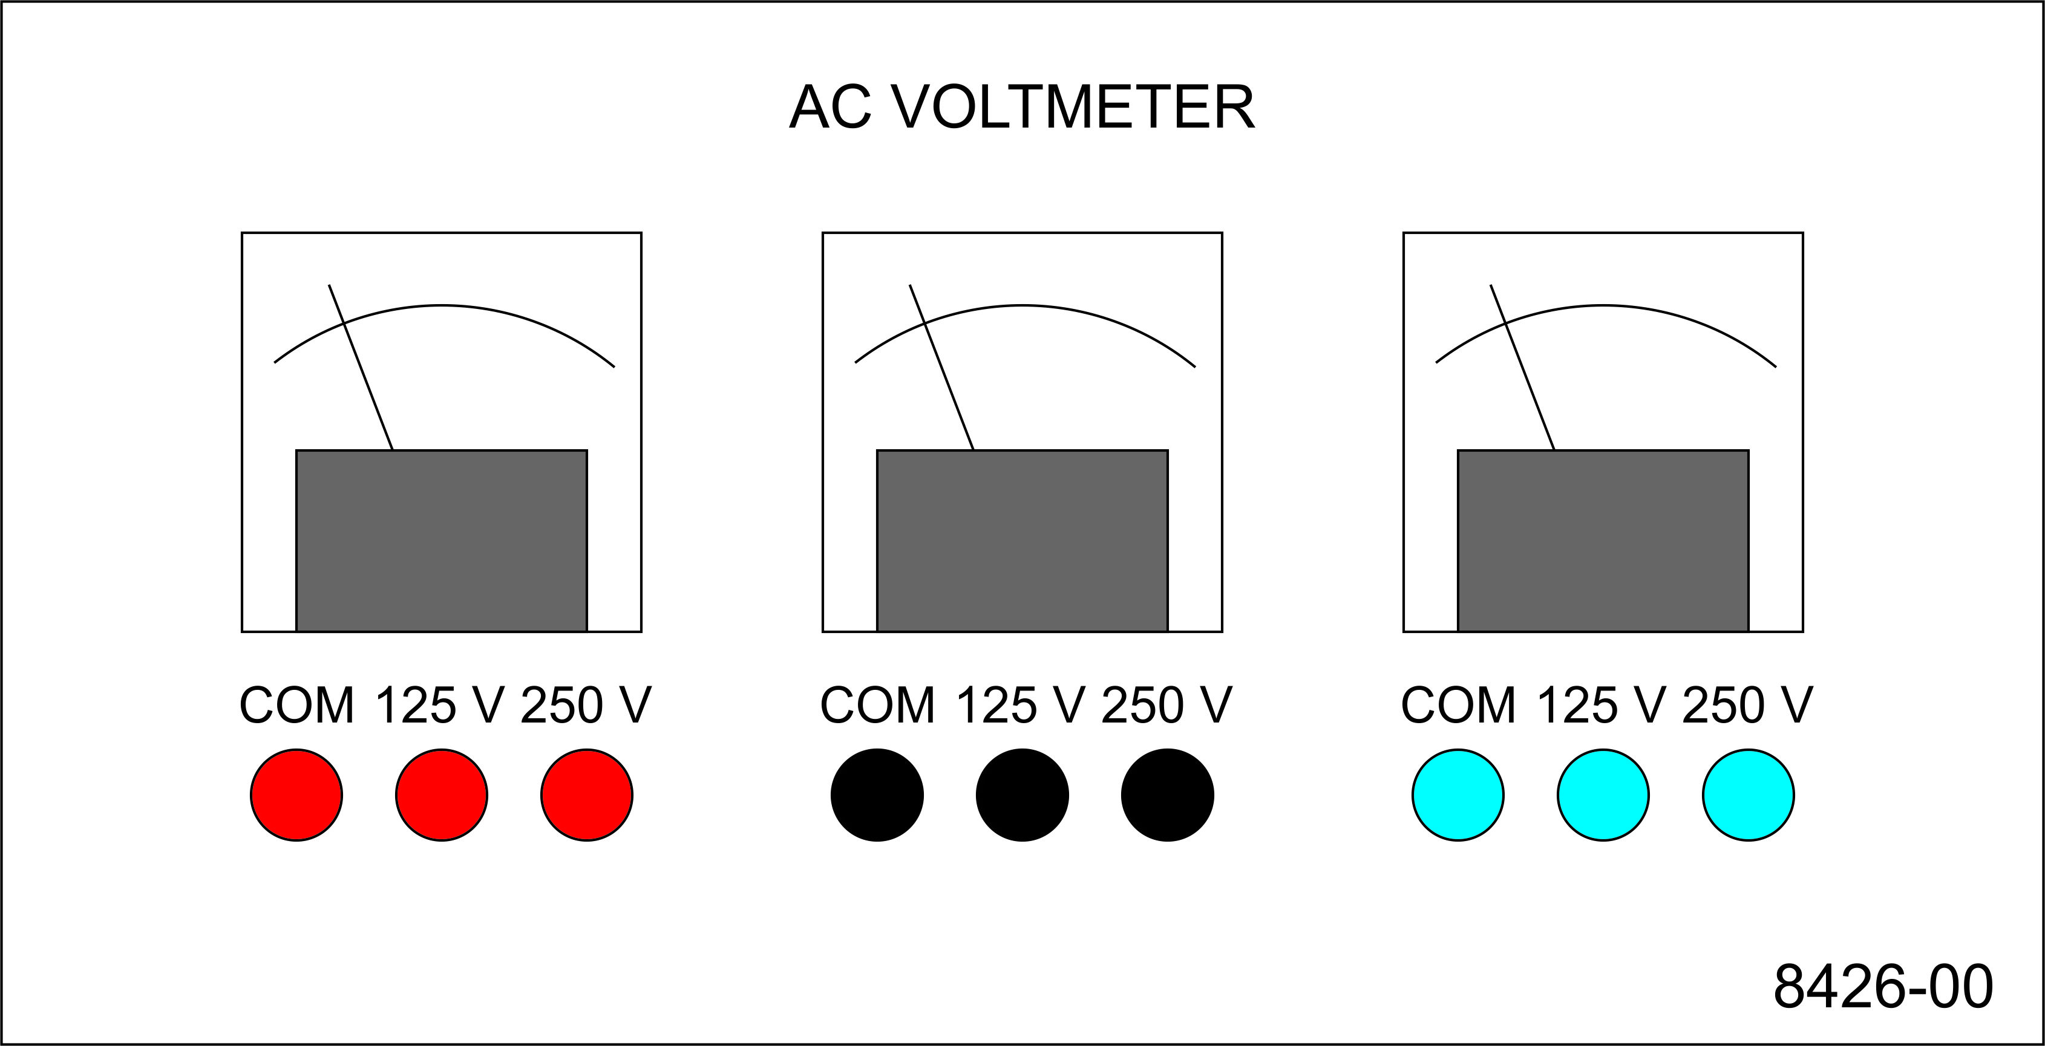
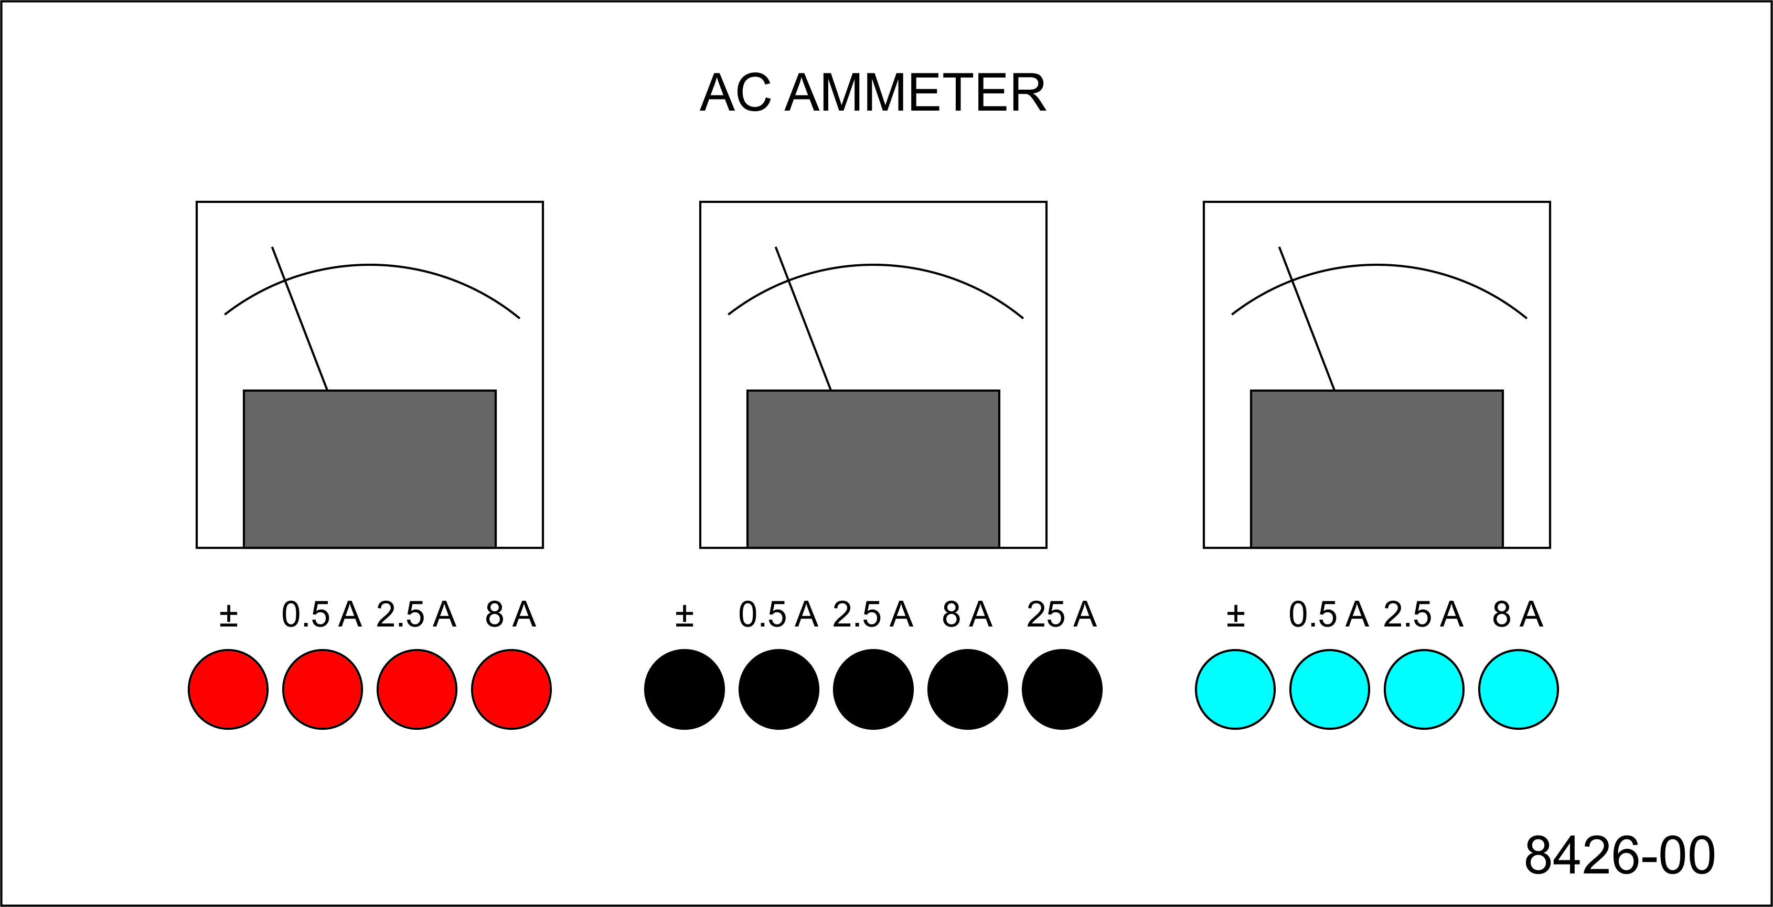
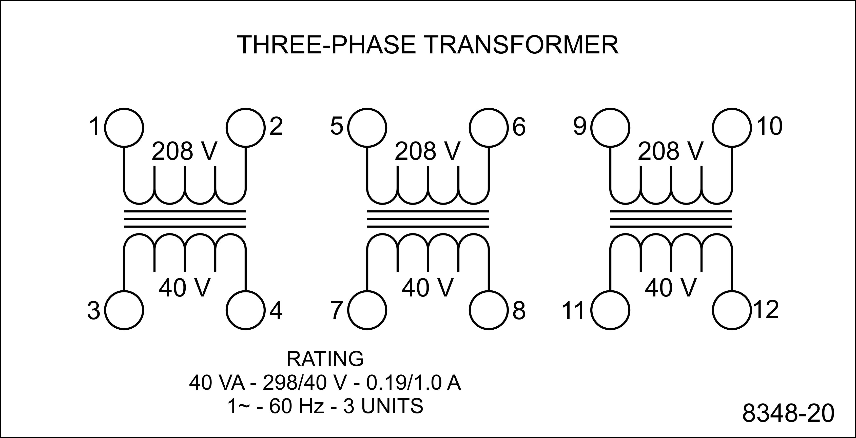
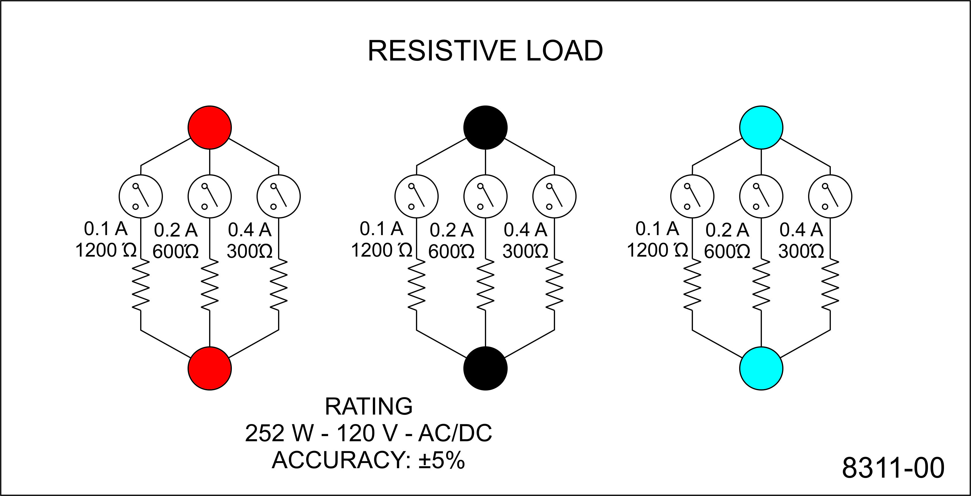
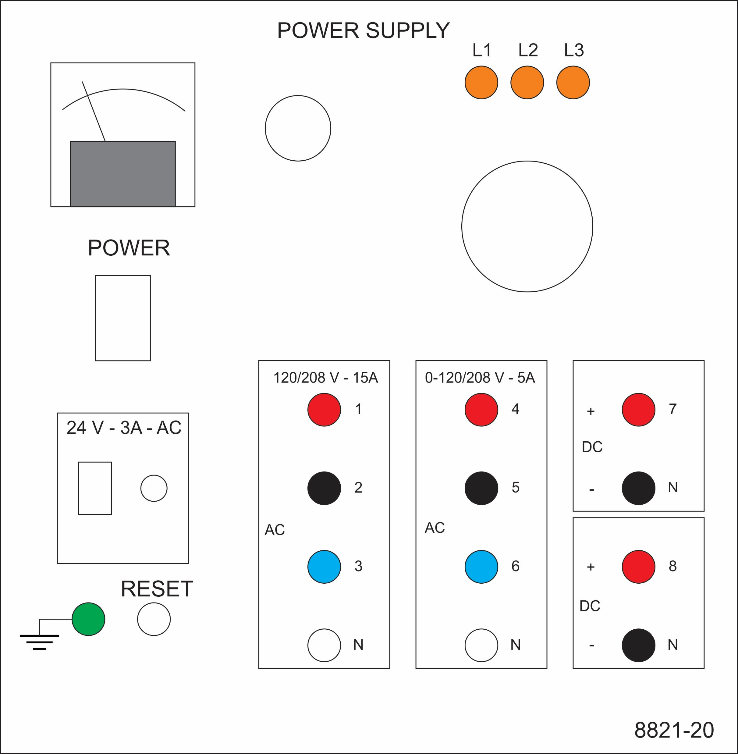
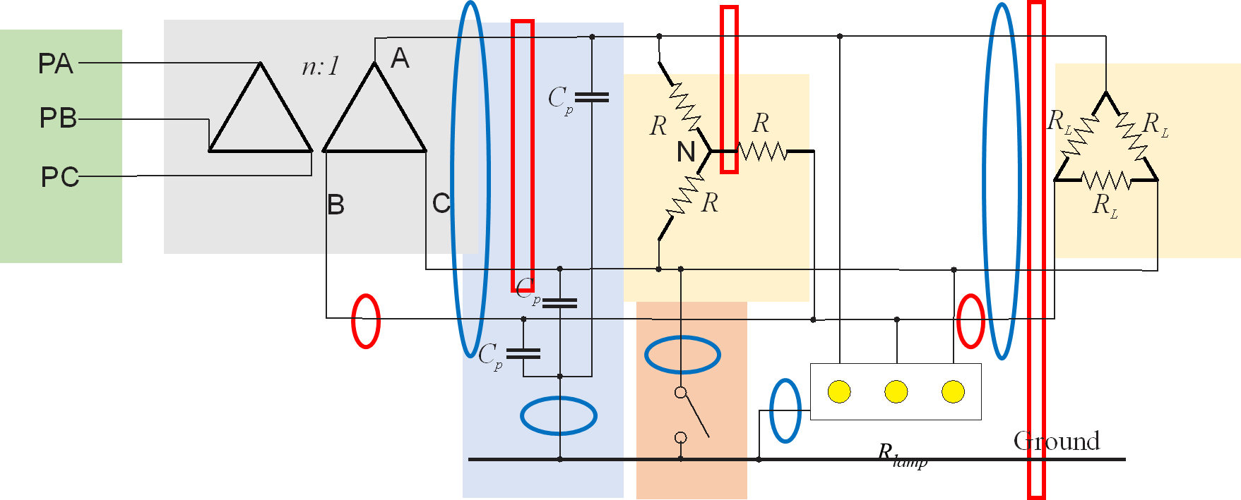
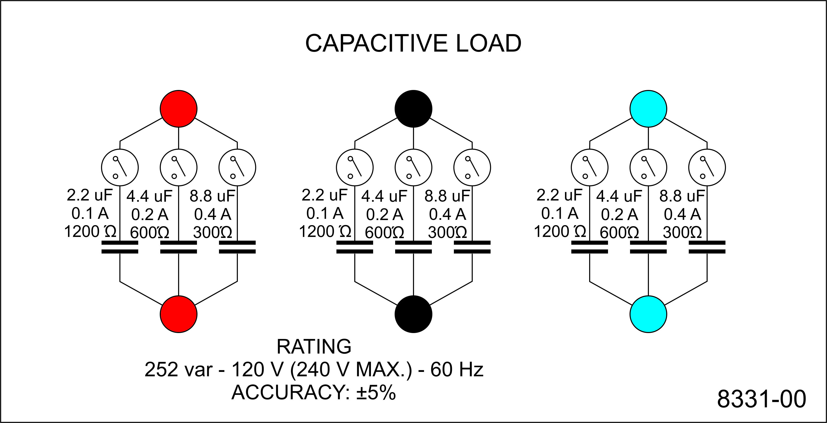
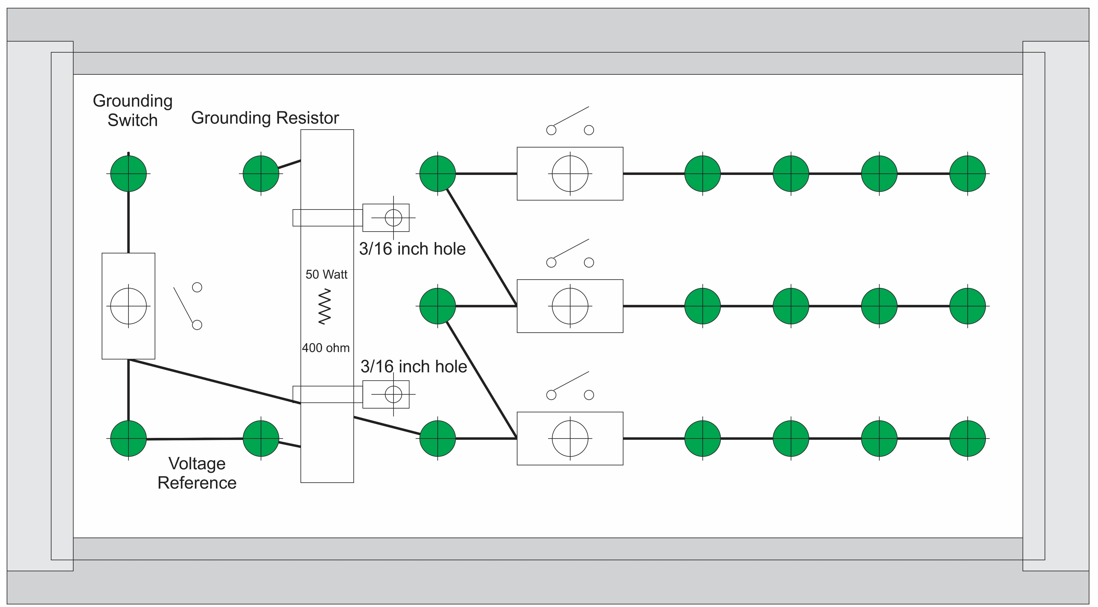
Experiment 2
Secondary - LL
Secondary - LN
Secondary - LG
Transformer line
Load line
Wye
Delta
Parasitic

Slide 4
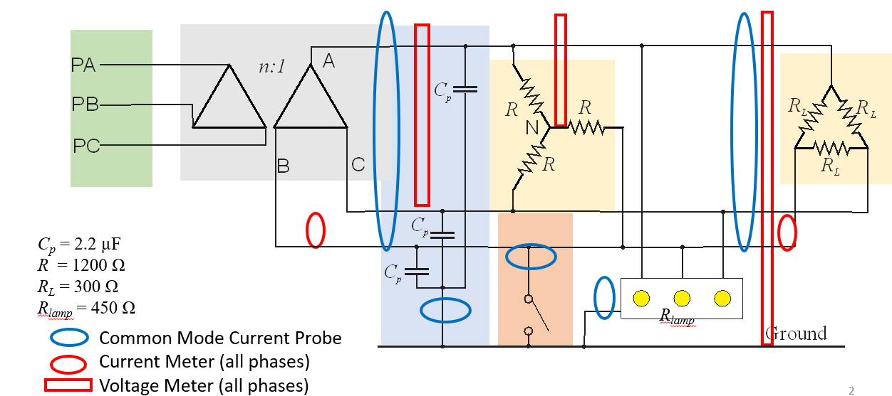
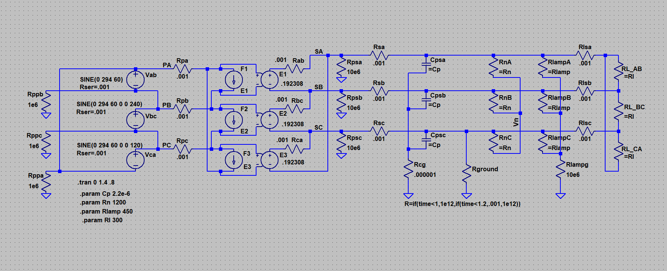
Simulation Model
LTspice
20240810 experiment 2.asc

Slide 5
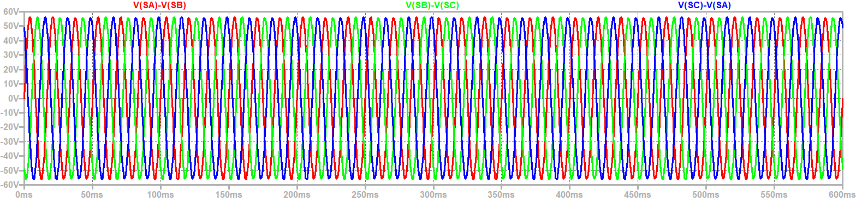
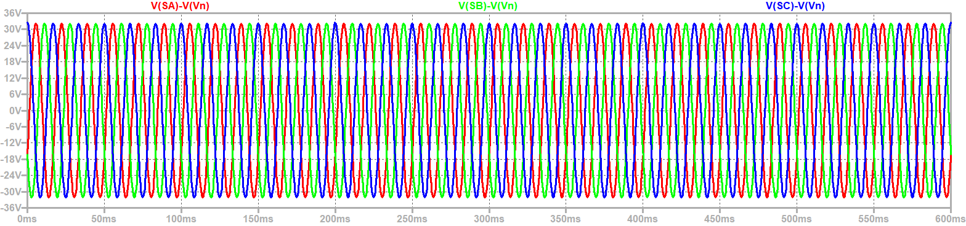
Line to Line and Line to Neutral Voltages Unchanged during ground fault
Ground Fault

Slide 6
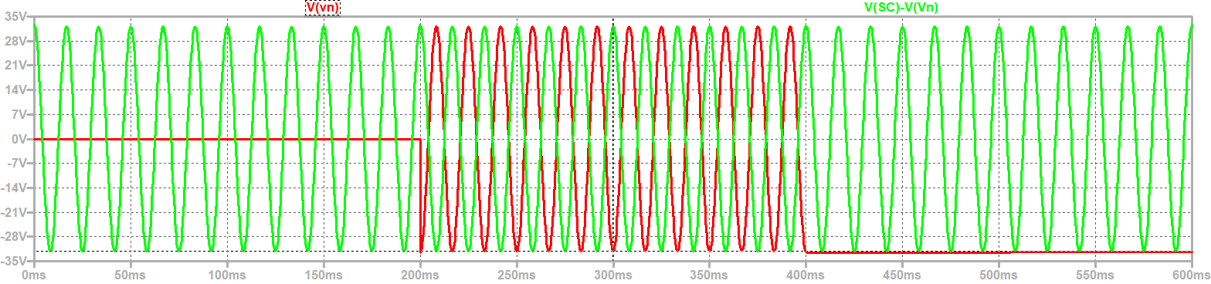
Neutral to ground voltage is negative line to ground voltage during a ground fault;
After fault clears, may have dc offset
Ground Fault
Note: Ground Lamps not connected to ground

Slide 7
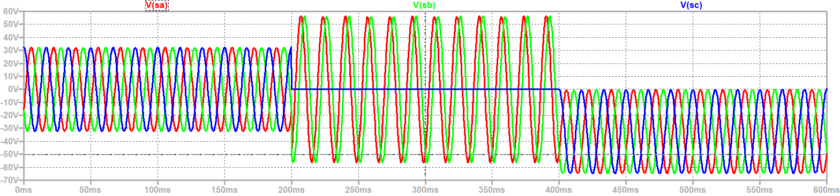
Phase to Ground Voltages
During Fault, line to ground voltages equal line to line voltages
Trapped Charge on capacitors may result in dc offset
Ground Fault
Note: Ground Lamps not connected to ground

Slide 8
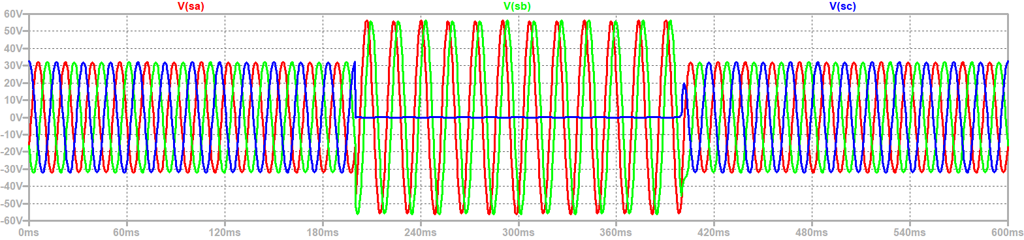
Ground Lamps: faulted phase light is out, others bright during ground fault
Lamp resistance dissipates trapped charge in parasitic capacitors
Ground Fault

Slide 9
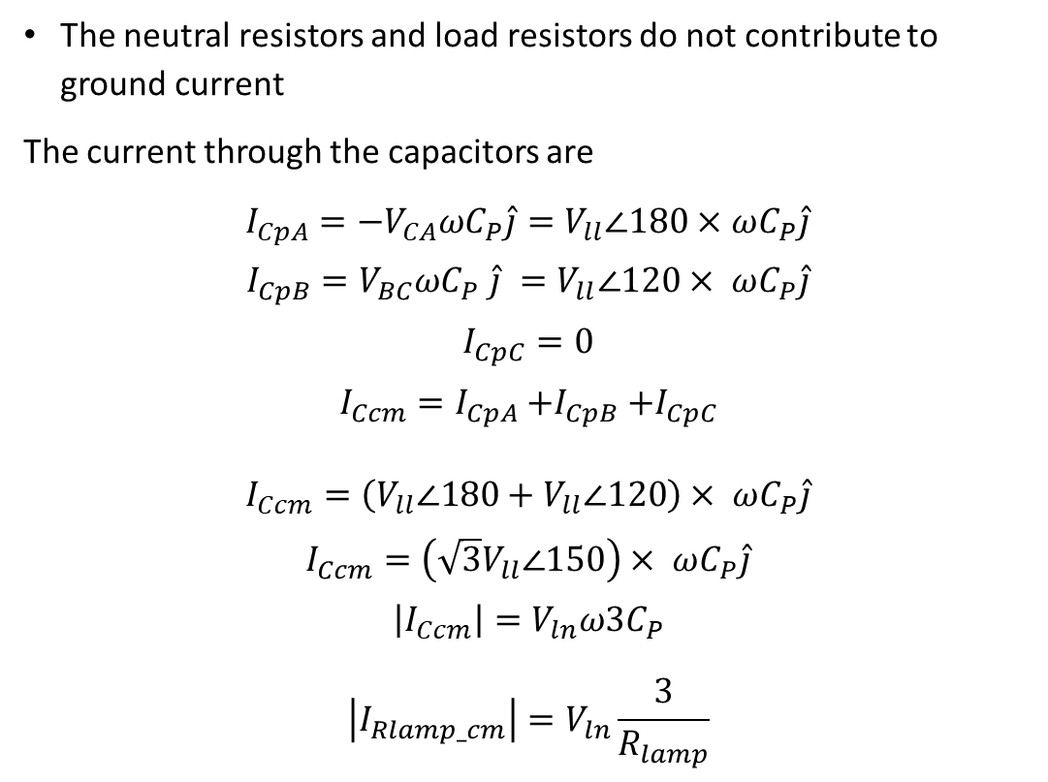
Ground Fault Currents (Common Mode)
The neutral resistors and load resistors do not contribute to ground current
The current through the capacitors are
$I_{CpA}={−V}_{CA}ωC_{P}\hat{j}=V_{ll}∠180×$ $ωC_{P}\hat{j}$
$$I_{CpB}=V_{BC}ωC_{P} \hat{j} =V_{ll}∠120× ωC_{P}\hat{j}$$
$$I_{CpC}=0$$
$$I_{Ccm}=I_{CpA}{+I}_{CpB}+I_{CpC}$$
$$I_{Ccm}=\left(V_{ll}∠180+V_{ll}∠120\right)× ωC_{P}\hat{j}$$
$$I_{Ccm}=\left({\sqrt{3}V}_{ll}∠150\right)× ωC_{P}\hat{j}$$
$$\left|I_{Ccm}\right|=V_{ln}ω{3C}_{P}$$
$$\left|I_{Rlamp_cm}\right|=V_{ln}\frac{3}{R_{lamp}}$$
Common Mode Equivalent Circuit

Slide 10
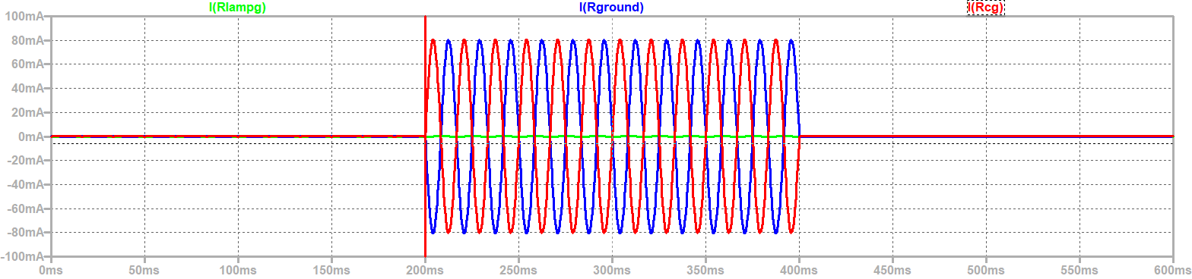
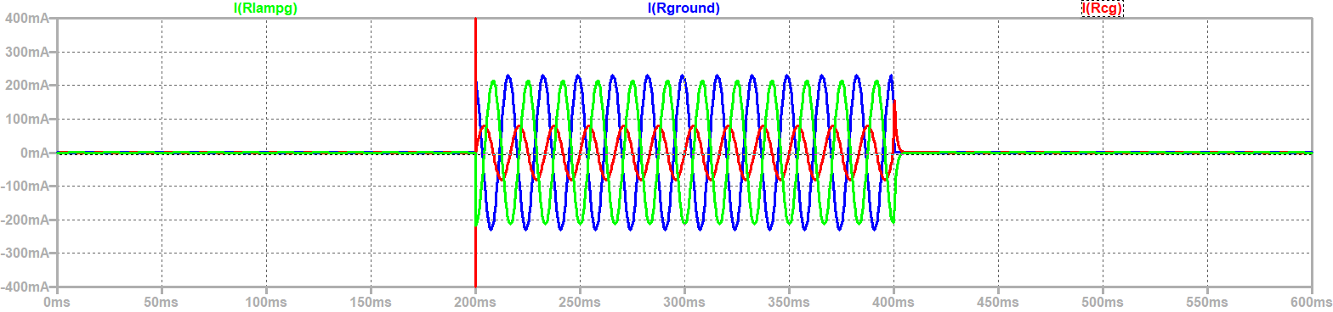
Common Mode Currents to ground
Without Ground Lamps
With Ground Lamps
Ground Fault

Slide 11
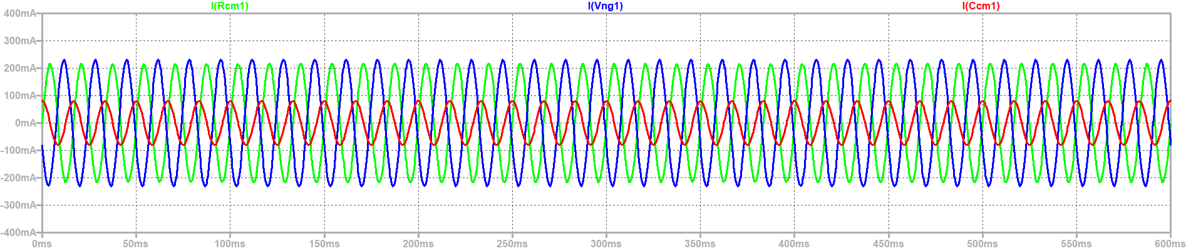

Common Mode Equivalent circuit produces same results
With Ground Lamps

Slide 12
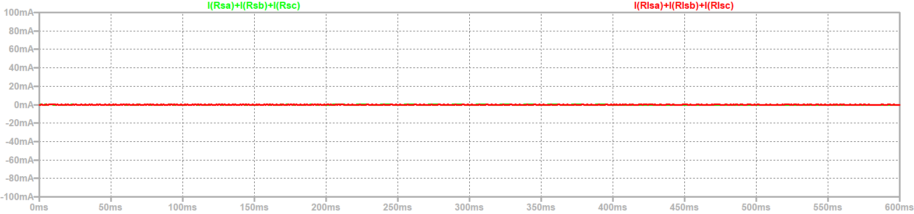
Common Mode Currents in bus
Kirchhoff Current Law (KCL) implies Comm mode current out of transformer is zero
KCL also implies Common mode current into delta load resistors is zero

Slide 13
Wrap Up

